Slide 1
Data Protection
Ji-Beom KIM

Slide 2
Outline
Weekly report
Summary of this week’s work
Your work
Conclusion
Your opinion/thought
Action item

Slide 3
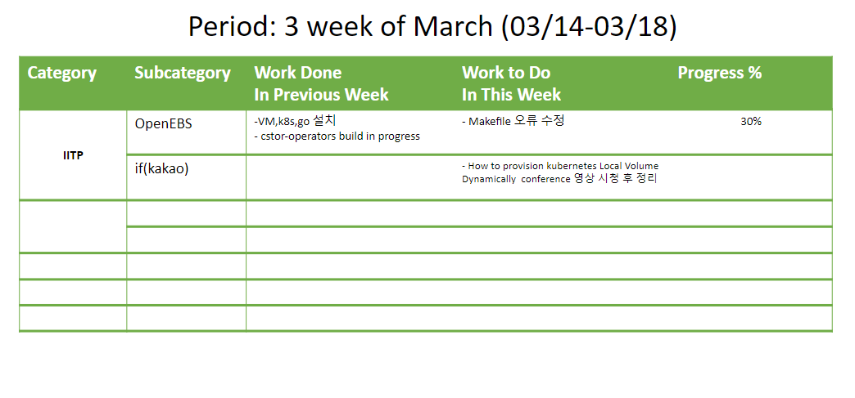
Weekly report

Slide 4
Summary of work this week
After watching the conference ‘How to provision kubernetes Local Volume Dynamically’ , organize it.
Cstor-operators build in progress
Makefile modification

Slide 5
How to Provision Kubernetes Local Volume Dynamically
JI-BEOM KIM

Slide 6
Your work(Environmental Constraints)
The kubernetes node we use has a single disk with one partition as the standard specification.
So we needed a way to dynamically allocate and use capabilities within one partition.
Single Disk Single Partition
Require Dynamic Capacity Allocation

Slide 7
Your work(Environmental Constraints)
There was no network storage at the time of project development.
Decided to use stable Local Volume because the main is DB service operation.
Absence of a Network Storage
Need for use Local Volume

Slide 8
Your work(Environmental Constraints)
Although there is a local volume provisioner provided by kubernetes, it only supports static provisioning.
Provisioner also support dynamic provisioning of local volumes, but in some cases we could not use them because we needed additional node environments such as lvm.
Absence of a Suitable Provisioner
Need to develop a New Provisioner

Slide 9
Your work(Functional Implementation)
First, a scheduler was needed to place the pod on the appropriate node according to the disk spare capacity of the node.
We need a provisioner to create PersistentVolume and mount it to the selected path of the selected node.
Scheduler
Pod scheduling with Dynamic Capacity Allocation
Provisioner
Dynamic Local PV Provisioner

Slide 10
Your work(Functional Implementation)
How to Add New Rules to Scheduler
First, re-compile after adding the desired features directly to the standard kubernetes scheduler.
Second, proprietary scheduler process that takes place instead of or in conjunction with the standard kubernetes scheduler.
Kubernetes Scheduler modification
Implementation of a new scheduler
Scheduler
Extender
Implementaion

Slide 11
Your work(Functional Implementation)
The previous two methods were not adopted in the process of modifying or creating a new scheduler because it was difficult to manage the version and complicated to implement.
Kubernetes Scheduler modification
Implementation of a new scheduler
Scheduler
Extender
Implementaion

Slide 12
Your work(Functional Implementation)
The third is to implement a Scheduler Extender that calls at the final stage of the kubernetes scheduler process.
Kubernetes Scheduler modification
Implementation of a new scheduler
Scheduler
Extender
Implementaion

Slide 13
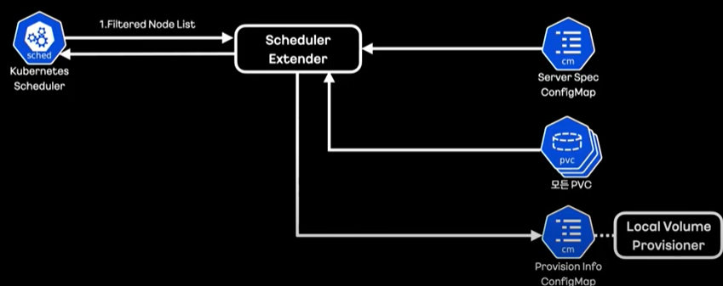
Your work(Scheduler Extender Architecture)
This is a brief flow of how the extender receives the information to filter and how the provisioner delivers it.

Slide 14
Your work(Scheduler Extender Architecture)
First, the extender receives a list of nodes filtered by kubernetes.

Slide 15
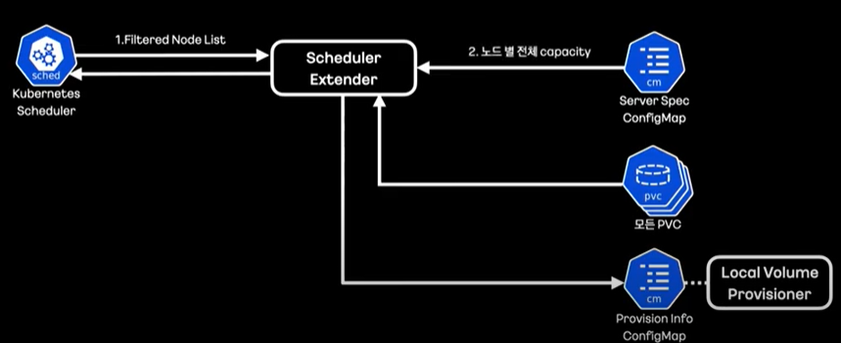
Your work(Scheduler Extender Architecture)
In addition, we manage the disk capacity of all nodes in a config map called Server Spac. Get this information as well.

Slide 16
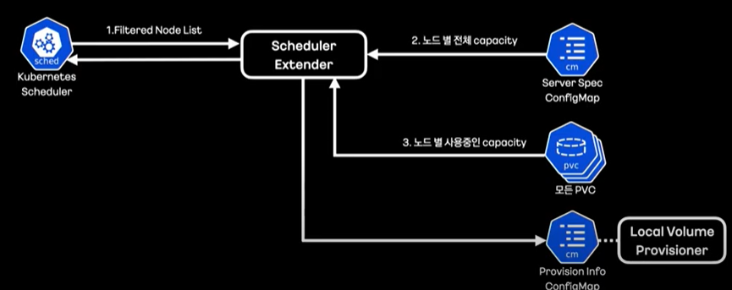
Your work(Scheduler Extender Architecture)
Obtain volume information mounted per node to determine the capacity currently in use.

Slide 17
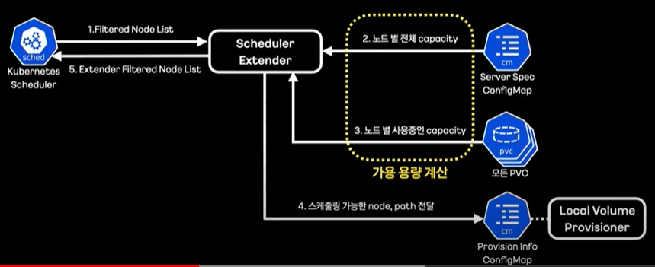
Your work(Scheduler Extender Architecture)
Based on the difference between total and unused capacity, we derive a mount path list for available uploads.

Slide 18
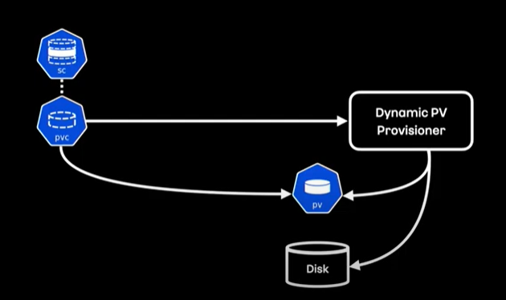
Your work(Dynamic PV Provisioner)
This is the basic dynamic PV provisional operation flow of Kubernetes.

Slide 19
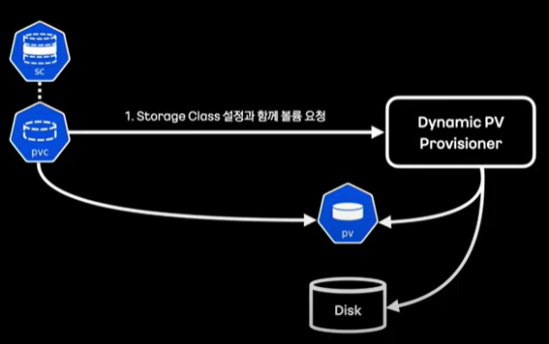
Your work(Dynamic PV Provisioner)
When a PVC is created, the dynamic provisioner will receive the storage class configuration specified in the PVC and the PVC specification.
The storage class can be seen as specifying what type of storage you want to use for dynamic pv provisioning.

Slide 20
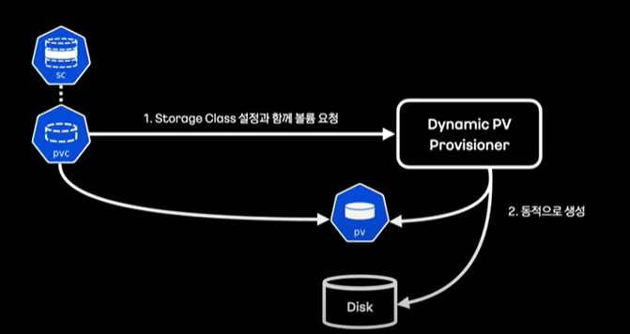
Your work(Dynamic PV Provisioner)
Provisions create PVs and mount volumes
At this point, the volume will mount the type of volume specified in the provisional field of the storage class.

Slide 21
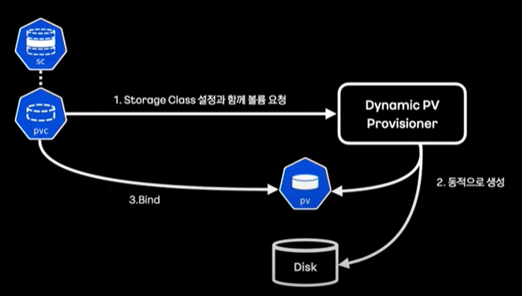
Your work(Dynamic PV Provisioner)
After the pv is created, the pvc is bound.

Slide 22
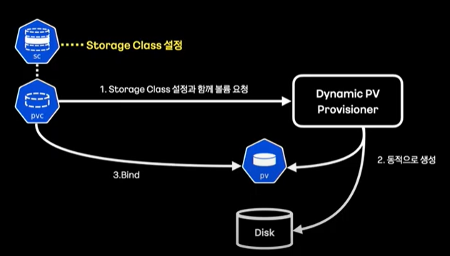
Your work(Dynamic PV Provisioner)
Created a storage class with provisional-specific settings.

Slide 23
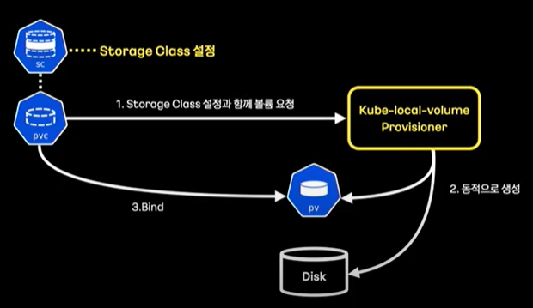
Your work(Dynamic PV Provisioner)
A new provisioner that directly implements dynamic local volume provisioning.

Slide 24
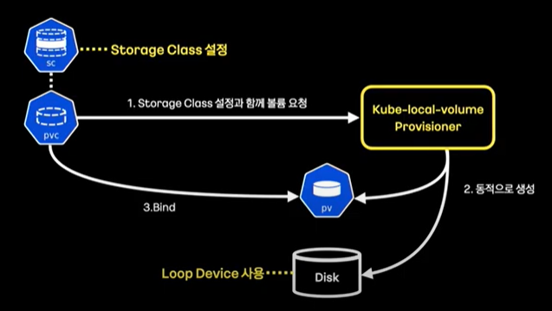
Your work(Dynamic PV Provisioner)
As a volume, we used a virtual device called a loop device to limit the capacity inside the partition.

Slide 25
Local Storage Service
Ji-beom KIM

Slide 26


Your work(install)
Os : centOS 7
k8s : v1.23.4
Golang : 1.13

Slide 27
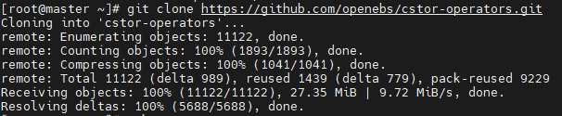

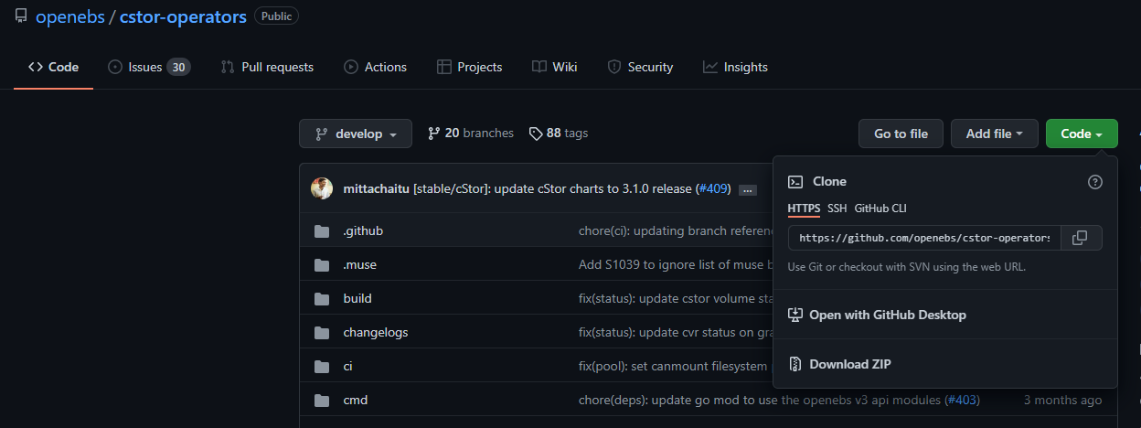
Your work(git clone)
Clones a repository(cstor-operators) into a newly created directory.

Slide 28

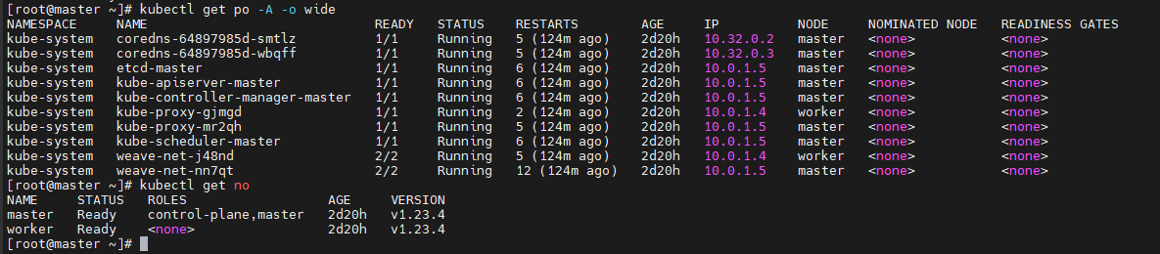
Your work(make)
Make The command works, but the pod doesn't go up.

Slide 29
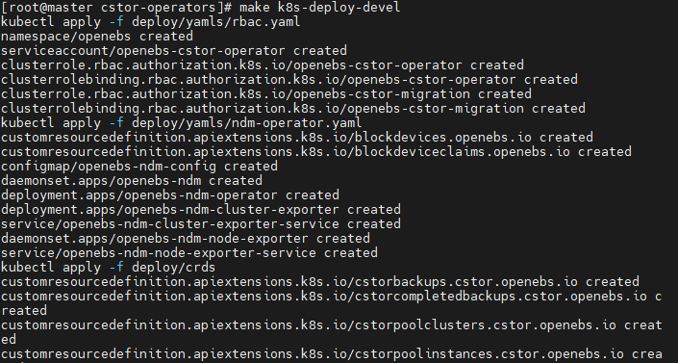
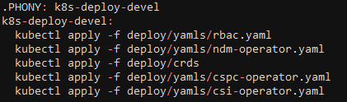
Your work(.PHONY)
The phony target is not the name of the actual file, but the target. There are two purposes for using the pony target.
1) To prevent conflicts with files of the same name
2) To improve performance
Command for run Phony target
$ make (Phony target name)
Phony target in Makefile

Slide 30
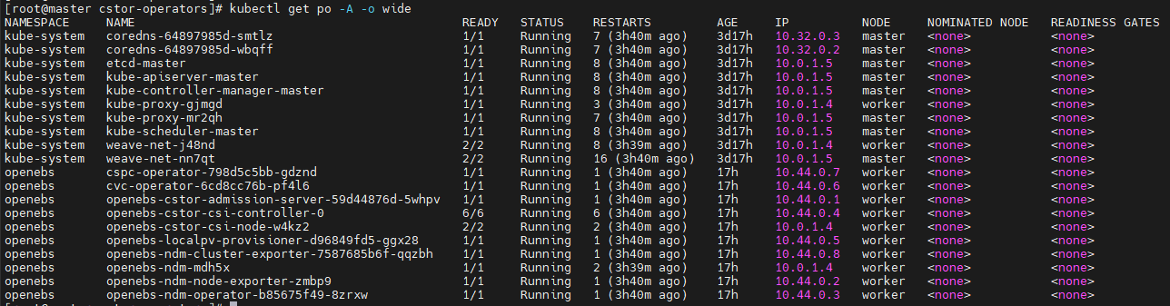
Your work(.PHONY)
The phony target is not the name of the actual file, but the target. There are two purposes for using the pony target.
1) To prevent conflicts with files of the same name
2) To improve performance
Check the pod goes up

Slide 31
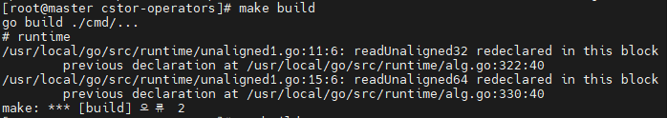
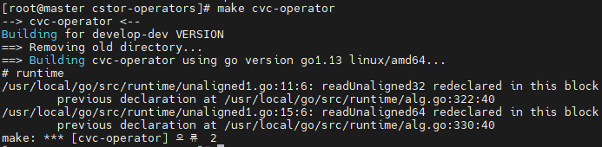
Your work(error)
However, errors occurred in other phony targets.
Error that a function with the same name was used.

Slide 32
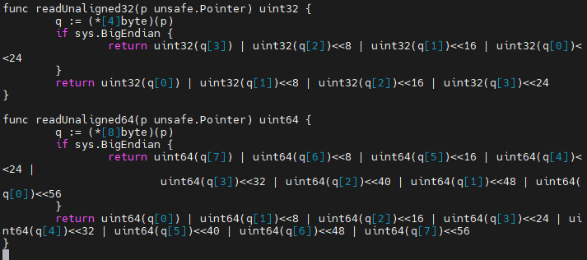
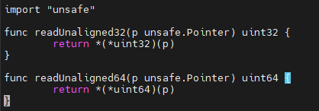
Your work(error)
However, errors occurred in other phony targets.
I tested the file to alternately annotate the functions, but another error occurred.
unaligned1.go
alg.go

Slide 33
Conclusion
We're a block device-based project, and this project is a host path-based project and we haven't found much to help.
have not solved the error yet.

Slide 34
Your opinion/thought
Makefile doesn’t work properly.
If the error is not resolved, klog cannot be added.

Slide 35
Action items
1. I will analyze the makefile more and correct the error.
2. Think of another way to create a container image and build a source code.

